Slide 1


Progress Since PRAGMA 18
Planning for PRAGMA’s Future
PRAGMA 19
13 – 15 September 2010

Slide 2
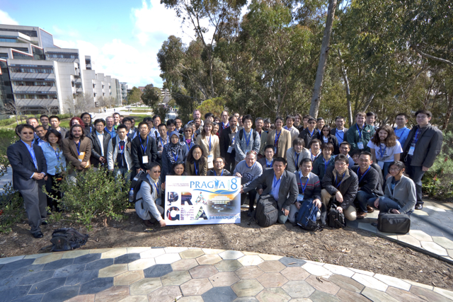
San Diego

Slide 3
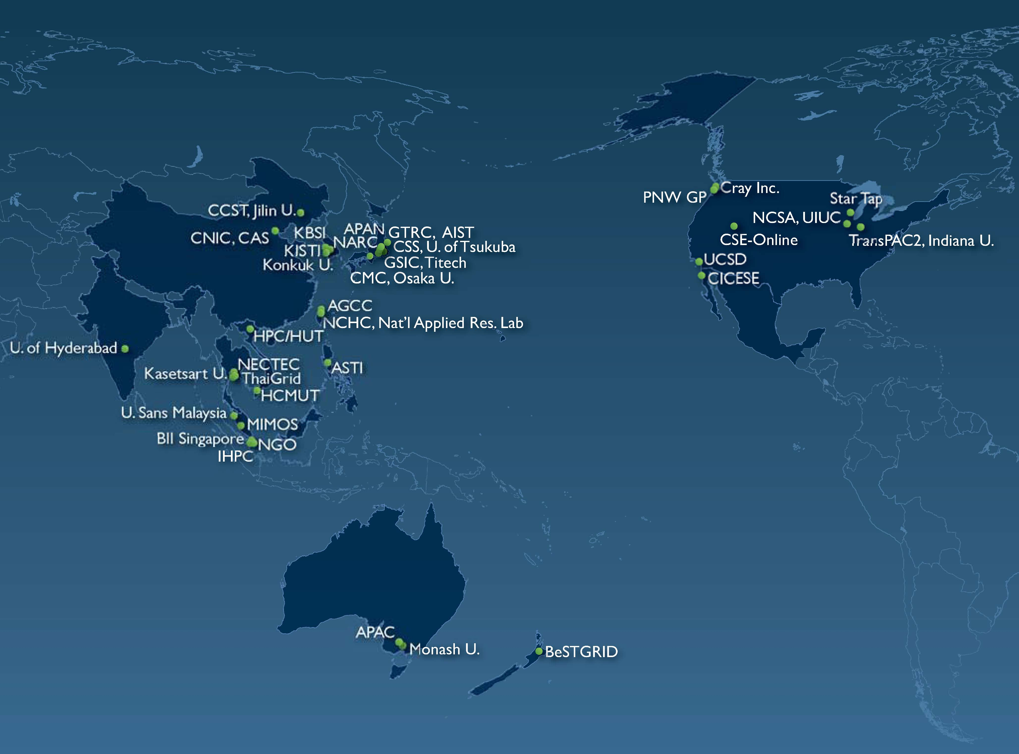
PRAGMA
A Practical Collaborative Framework
IOIT-VN
Strengthen Existing and Establish New Collaborations
Work with Science Teams to Advance Grid Technologies and Improve the Underlying Infrastructure
In the Pacific Rim and Globally
http://www.pragma-grid.net
Notes:
35 Members

Slide 4
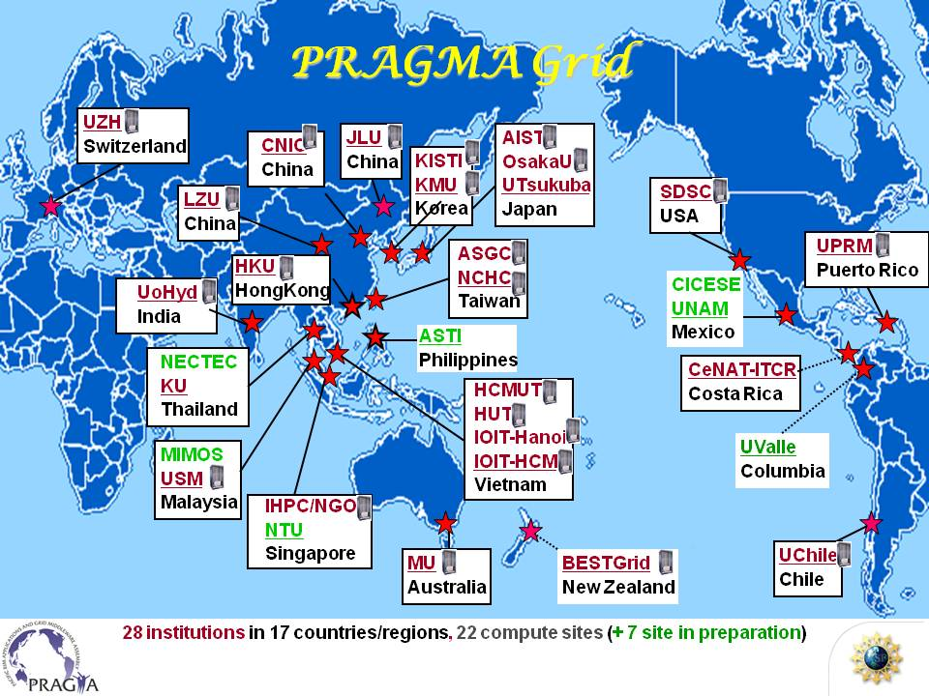
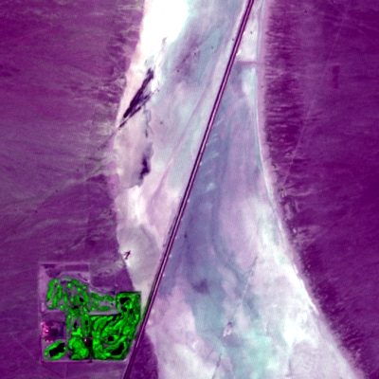
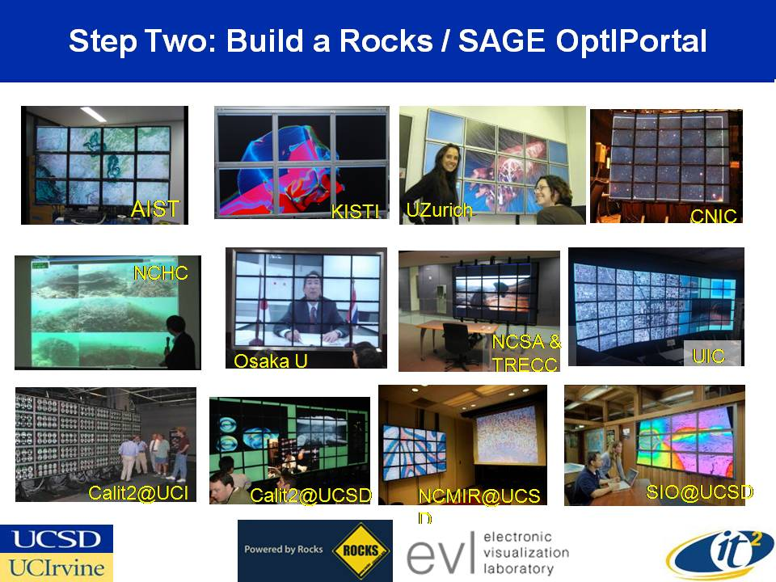
Working Groups: Organize Activities
Resources
Biosciences
March 2010
Telescience
GEO

Slide 5
PRAGMA Institute on Virtualization and Implementation
At PRAGMA 18 collaboration formed with Costa Rica Institute of Technology (ITCR), Monash University, UCSD, AIST and U Tsukuba.
Team wrote and received Amazon EC2 account ($3,500, ~40,000 ECU)
Next steps involved collaboration between ITCR and Monash
Result “NG-TEPHRA: A Massively Parallel, Nimrod/G-enabled Volcanic Simulation in the Grid and the Cloud” (submitted e-science 2010)
Next steps: run in Rocks/Condor framework

Slide 6
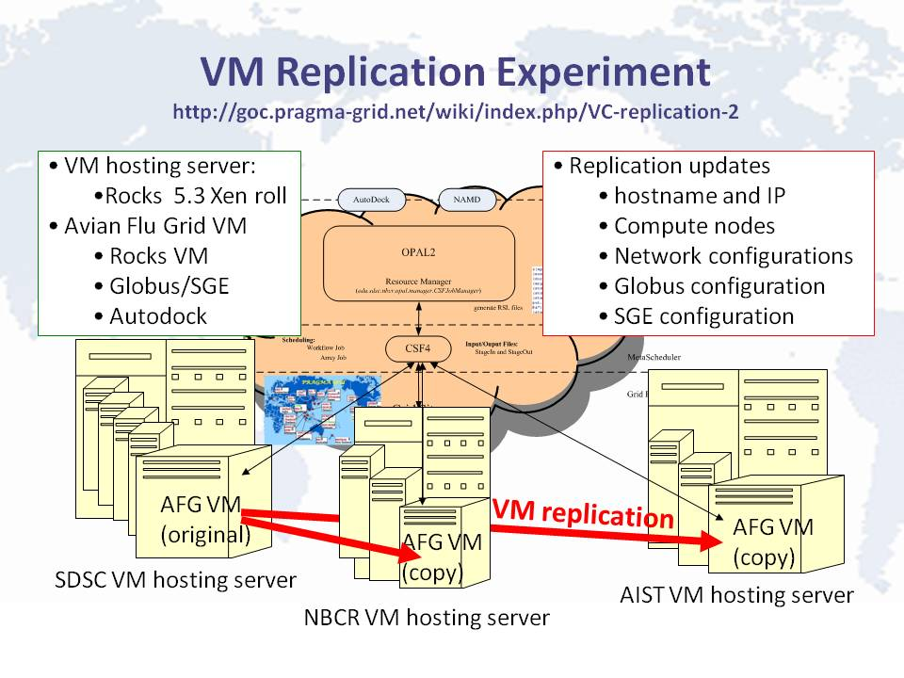


Virtualization Experiment Avian Flu Grid (AFG)
UCSD and NBCR: VM for AFG
NBCR AIST: replicate AFG VM to Rocks VM servers.
See http://goc.pragma-grid.net/
wiki/index.php/VC-replication-3
Notes:
10Sep10: AFG now run on a replicated VM at NBCR site as well.
SDSC/AIST/NBCR continue their virtualization research effort.
SDSC and NBCR worked together and setup a VM for Avian Flu Grid
application. This VM has been replicated and tested successfully
within the same VM hosting server. The procedure is documented
at http://goc.pragma-grid.net/wiki/index.php/VC-replication-3.
AIST and NBCR are working on replicate the Avian Flu Grid VM to
their Rocks VM hosting servers.
AIST is also working on virtual cluster evaluation, very fast
live-migration of VM images, cloud security and high-performance GSI
With Phil and Mason's help, we were able to replicate AFG VM image here. AIST (Ota-san) and NBCR (Nadya) are working on replicating the AFG VM image on their VM hosting servers. AIST is almost done. Hopefully Ota-san can finish early next week- in time to confirm result with testing before PRAGMA 19.

Slide 7
PRAGMA 19 Implementation Institute
Overview of technologies and approaches in Avian Flu Grid
CSF4 (Jilin), Opal (NBCR), Gfarm (U Tsukuba)
Replication of virtual clusters (UCSD, NBCR, AIST)
Implementation
Gfarm integration
Sharing of virtual clusters
Look forward to an update at end of meeting

Slide 8
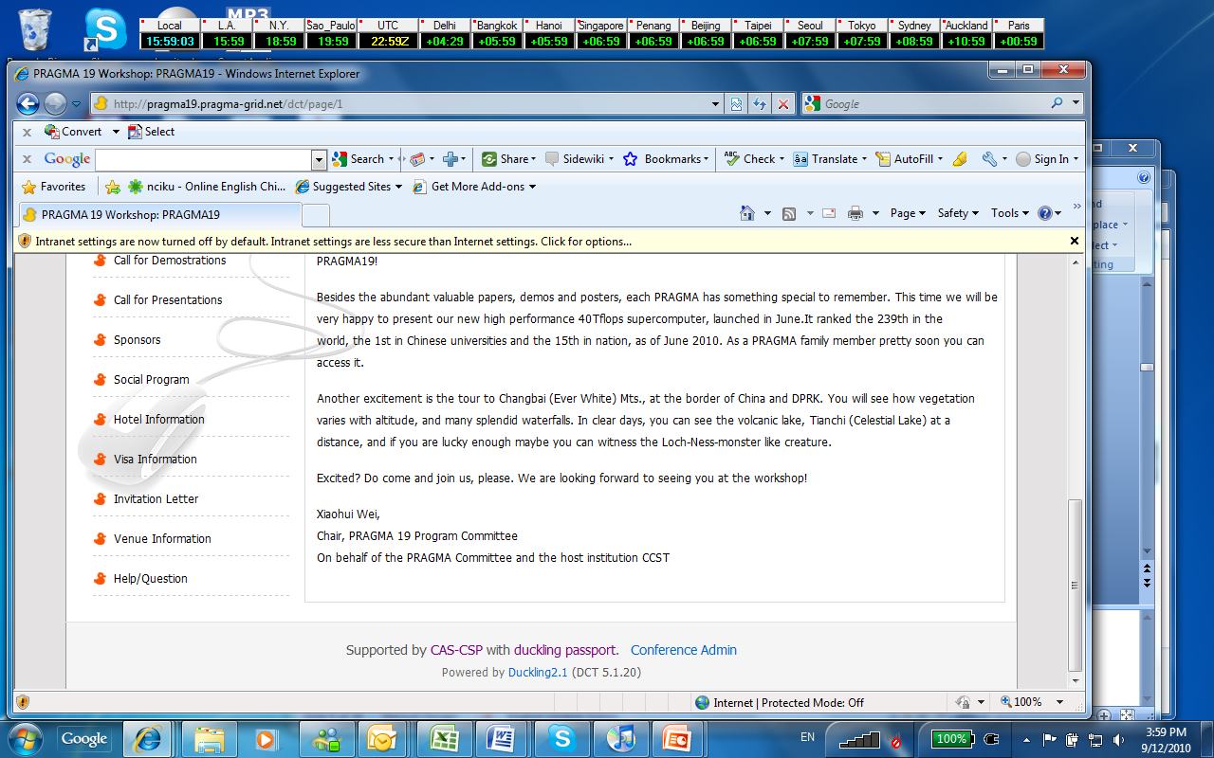

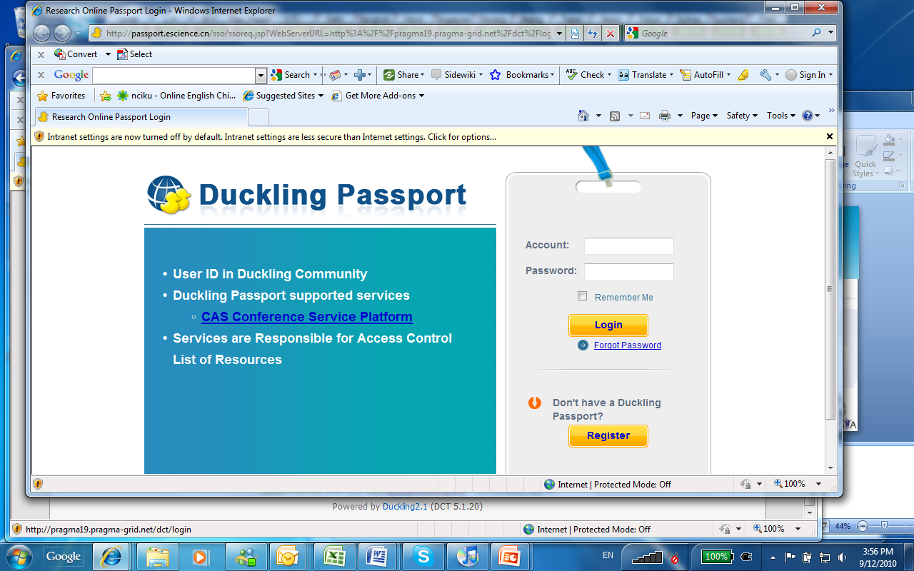

Other Resource Updates
Conference Service Platform (CSP) (Duckling version2.0 - based) and deployed/supports PRAGMA19
Thank users and CNIC (Kevin) for improvements
UTsukuba has released Gfarm 2.3.2 and 2.4.0 in July 2010. The most stable version 2.3.2 supports automatic replica creation. The version 2.4.0 is a major update that supports update based replica consistency management that keeps the number of file replicas.

Slide 9
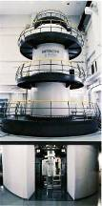
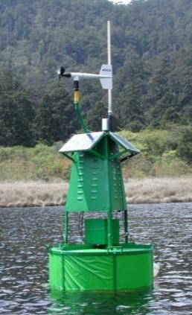

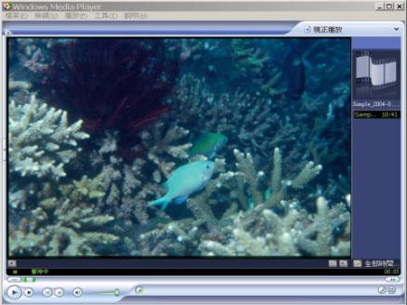
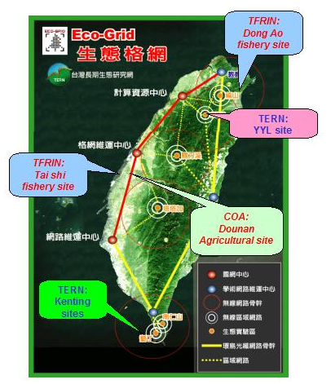
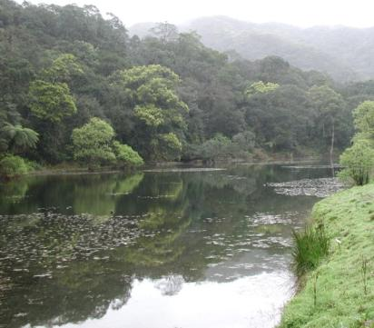
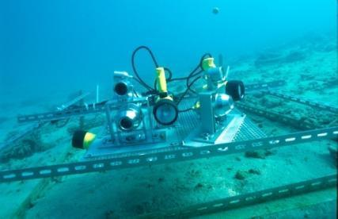
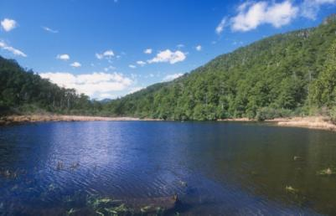
Ecogrid: An Outgrowth of PRAGMA Telescience
Notes:
PRAGMA
- Experience
- People infrastructure – and trust
- Catalyzed interactions

Slide 10
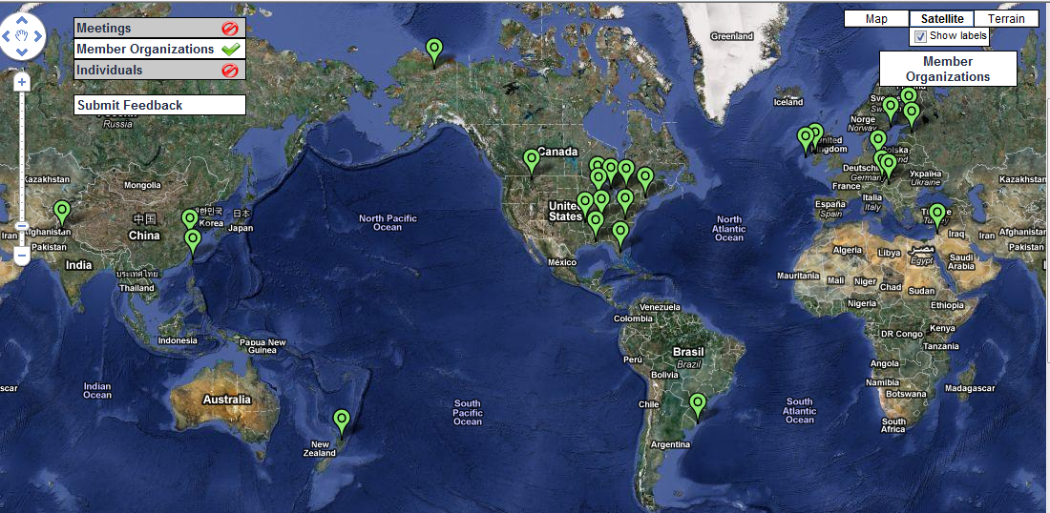
GLEON: revolutionizing understanding of aquatic ecosystems through an international grassroots network of people, data, and lake observatories
28 Site Members (sites shown)
208 Individual Members (5Sep10)

Slide 11
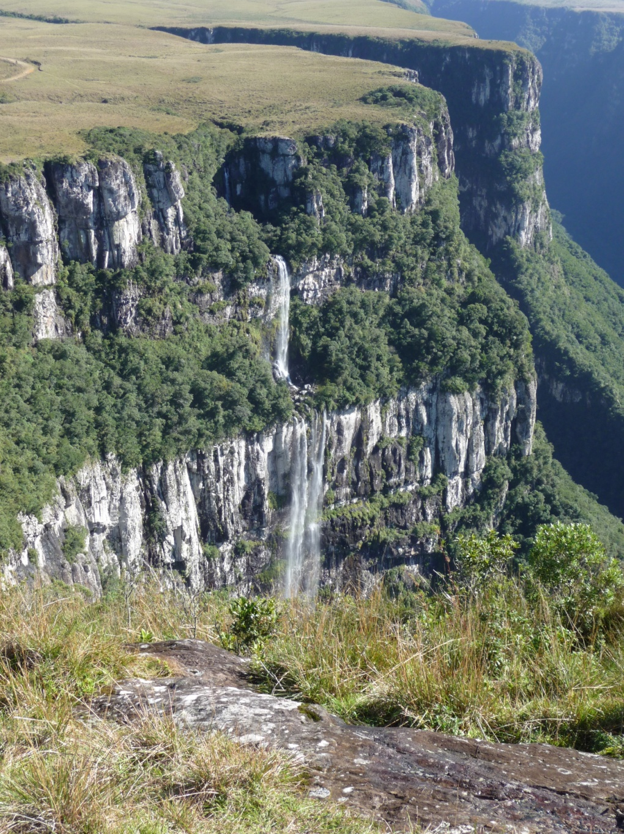
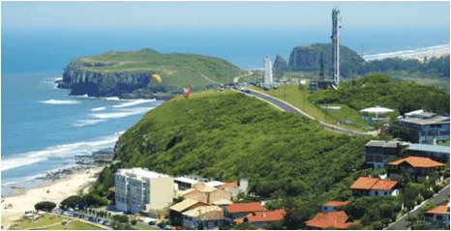
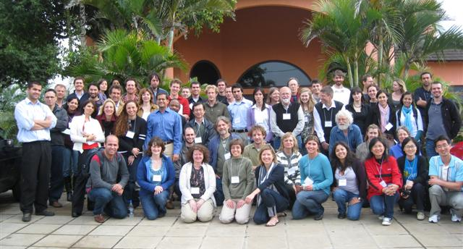
GLEON 10 Meeting Torres, RS Brazil May 2010

Slide 12
Routine Use of GEO Science Infrastructure in PRAGMA
Yoshio Tanaka, Ryosuke Nakamura, Sarawut Ninsawat, Naotaka Yamamoto, Satoshi Sekiguchi (AIST, Japan)
Bo Cheng (NSPO, Taiwan), Franz Cheng (NARL, Taiwan)
Cindy Zheng (SDSC, USA)
Are you interested in Satellite Data?
Source: Yoshio Tanaka
GLEON 10 Meeting
May 2010, Brazil

Slide 13
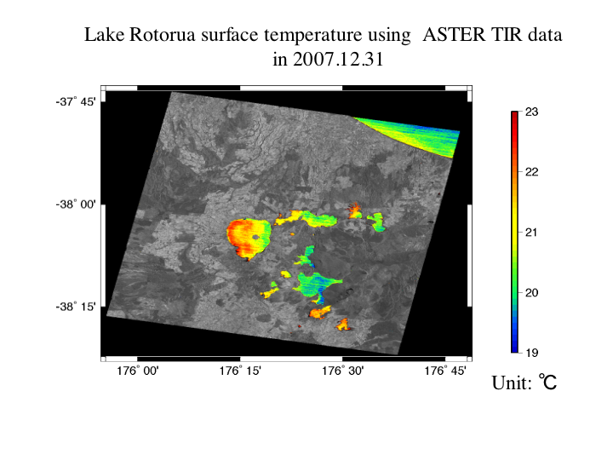
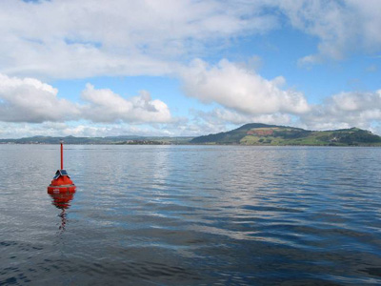
Source: Yoshio Tanaka

Slide 14
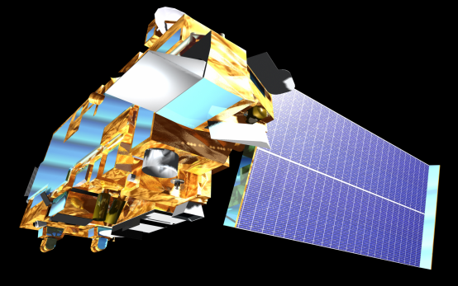
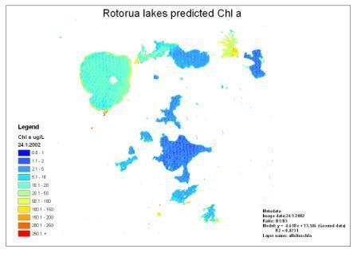

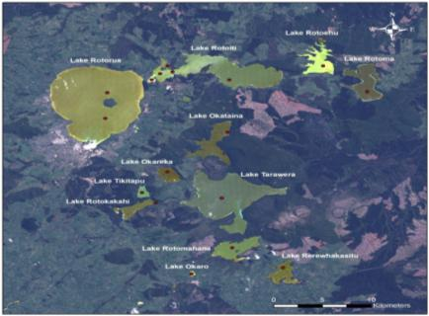
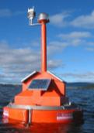
Synergy of satellite and field data
SOS=Sensor Net
WPS= Satellite data processing
Accurate water quality map production with GLEON
Source: Yoshio Tanaka

Slide 15
How COOL is this demo?
PRAGMA GEO Science WG has started routine-use of PRAGMA GEO Science Infrastructure which provides services for accessing satellite data including
ASTER data provided by AIST, Japan
Formosat-2 data provided by NSPO, Taiwan (will be available soon)
Both ASTER and Formosat-2 data are NOT free data but need access control by Grid security
You don’t need to understand the details of underlying security
You can access by username/password!
Source: Yoshio Tanaka
May 2010
Notes:
https://geo.pragma-grid.net/

Slide 16
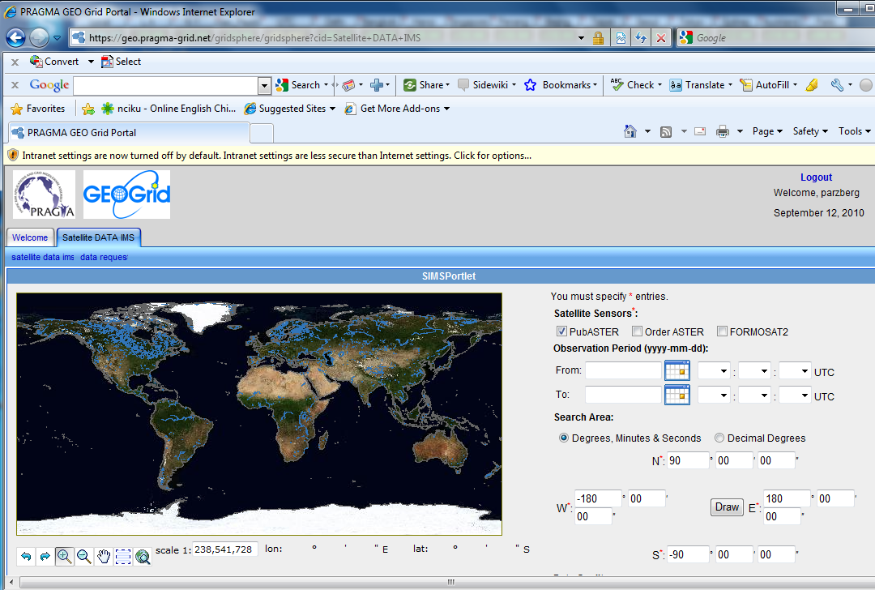

Slide 17
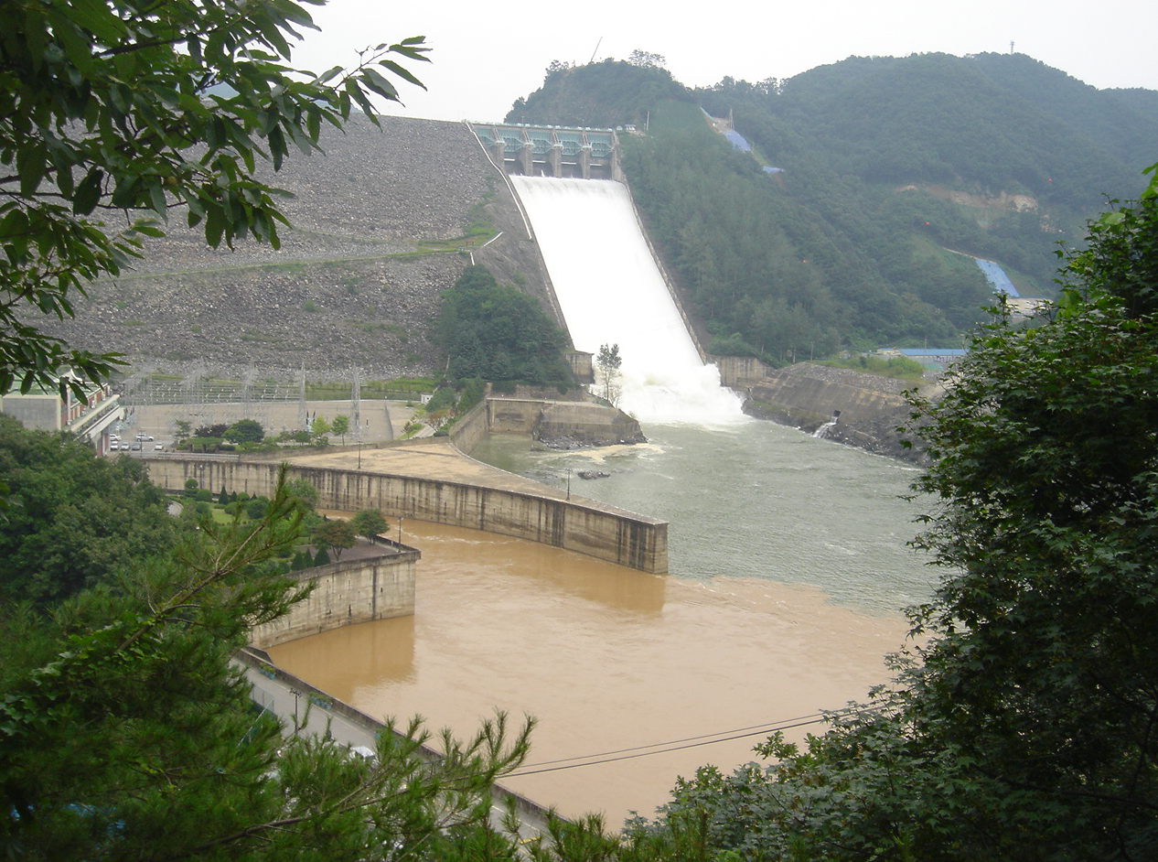
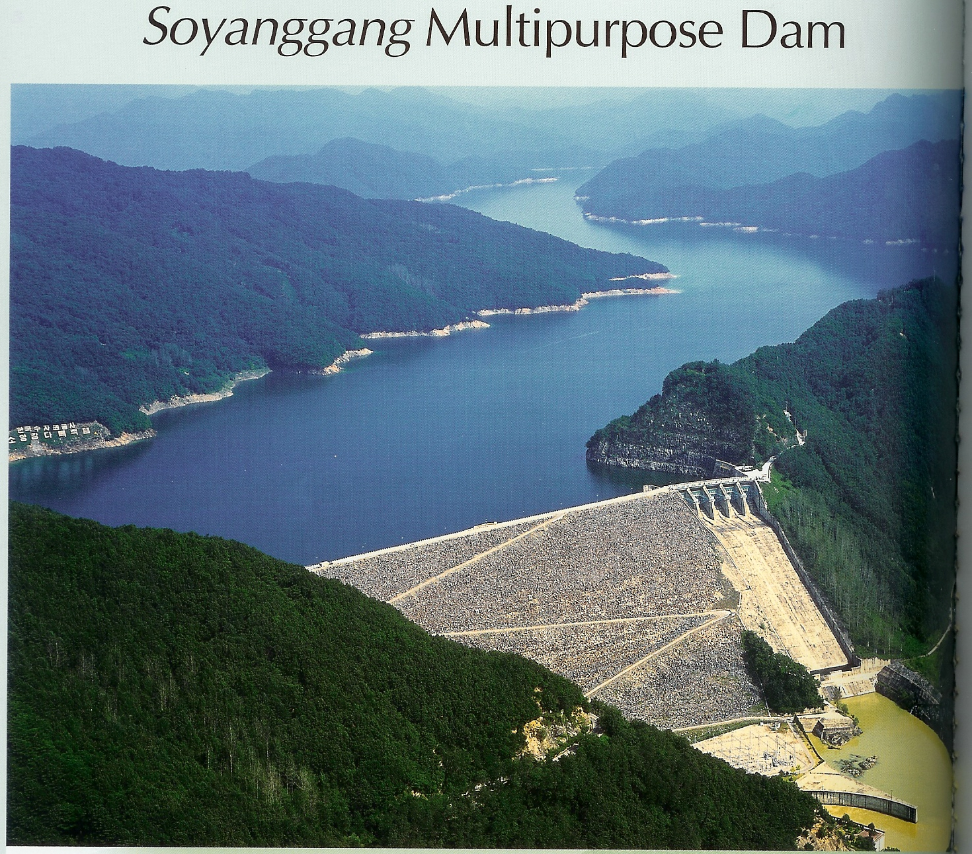
A clear lake discharging
turbid water (Lake Soyang)
Source: Bomchul Kim
Notes:
Dear Peter
At present they don't have any choice because power plant outlet is made at the middle depth of the dam.
Actually it is preferable because we can withdraw turbid water within shorter time.
Fine particles do not settle down easily within a few months, and turbid water is dispersed to the surface layer in autumn (cooling season) if it is not discharged all, which gives bigger damage to the lake ecosystem. It happened last year.
The Kowaco is planning to build a selective withdrawal facility in Lake Soyang, which will allow them to discharge clear surface water during a critical period of water recreation and supply water resources to Chuncheon city, and discharge turbid middle layer on rainy days or less critical autumn season.
Bomchul
Yes, runoff after storms adds water with particles associated. The temperature of the water running into the lake (with the turbidity) determines what depth it will sink to in the lake (essentially it will go the layer with the same temperature, or more precisely, the same density). Usually the dam operators can select which depth of water to draw from and let through the dam. So in the picture below, above the dam the turbid water is probably in a layer well below the surface and it is this layer that is being let through the dam.
Make sense?
tim
4 September 2007
Yes. It shows just the story.
Now turbid water discharge in ongoing this year, too. If you come to North Han River or Lake Paldang, you can see the river is full of turbid water. This year lost (lots-PA) of turbid water came from North Korea.
The photo of Lake Euiam is a photo of turbid water, too. It was taken last year after storm.
Bomchul
Does the third slide (you just sent – titled A clear lake discharging turbid water (Lake Soyang) reflect the story you sent me in May (below)?
Peter
Complaint of turbid water supply began in Chunchon city (my city far upstream of Seoul) not in Seoul. Turbid water occurred every summer (Monsoon rains) but the government in downstream did not pay attention until last summer storm event in spite of my repeated warning through many reports and masscom articles based on my long term monitoring.
Long term monitoring showed that turbid runoff occurs every summer and the turbidity fluctuated but obviously had increased within the last 10 years. Total phosphorus also has increased and this omen of eutrophication is recognized and the government is planning a TMDL of phosphorus in near future.
Now government began to move toward controlling agricultural activity. Industry is not suppressed in the upstream area because there is not active industrial activity in the watershed of Seoul water supply.
From Bomchul Kim – communicated on 7 May 2007

Slide 18
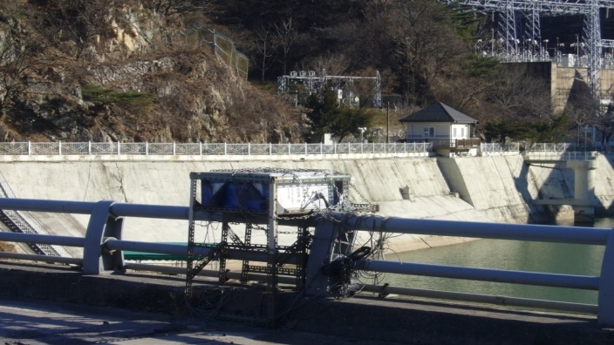


Korean Lake Ecological Observatory Network (KLEON)
Installation of sensors
Lake - Soyang, Euiam, Youngrang, River -Anyang, Han, Gapyeong
(Nearly) Real time sensor data monitoring on the web
Data management progress
Sampling data; sensor information management
Web interface with Google earth
Poster Session
Dr. Youngjin Jeong
Notes:
Dear Peter,
Here is our activities including GLEON collaboration. We have working with Kangwon Univ.(Prof. Bumchul Kim). Our Project name is KLEON.
1. Installation of sensors such as temperature, conductivity, pH, LDO, TDG, Turbidity
- Data transmission with CDMA or RF modem
- Site ( Lake - Soyang, Euiam, Youngrang, River -Anyang, Han, Gapyeong )
2. (Nearly) Real time sensor data monitoring on the web
- Data view with graph
- CSV and xml file download for getting observations.
3. Data Management
- Sampling data management with vega of GLEON.
(Water quality and plankton data for more 20 years is provided)
- Observatory information management.
(Observation site, lake, dam, floodgate, and weather)
- Sensor information management with SensorML of OGC (Open Geospatial Consortium)
(ex - Model no., sampling interval, error rate of the sensors)
4. Web interface with Google earth
- When a user search the observations, Google earth is used to provide the position
of sampling sites or the shape of lake.
Our staff (Dr. Youngjin Jeong) have a plan to introduce KLEON at the poster session and the working group of PRAGMA 19.
Thank you.
Best,
Kum Won

Slide 19
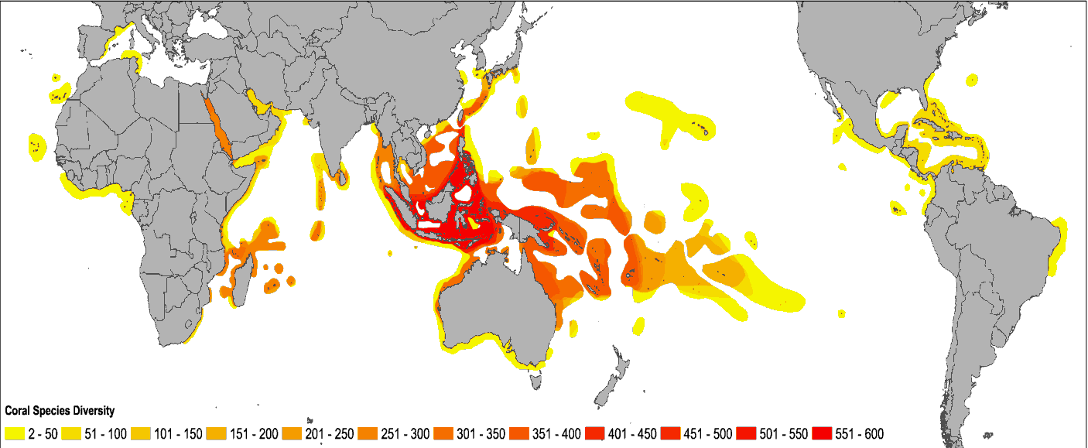

Coral Reef Environmental Observatory Network (CREON)
Orchid Island
Kenting
NOAA
Racha Island
GBR
Moorea
Source: Stuart Kininmonth, AIMS
Source : Fang-Pang Lin, NCHC
http://www.coralreefeon.org/

Slide 20

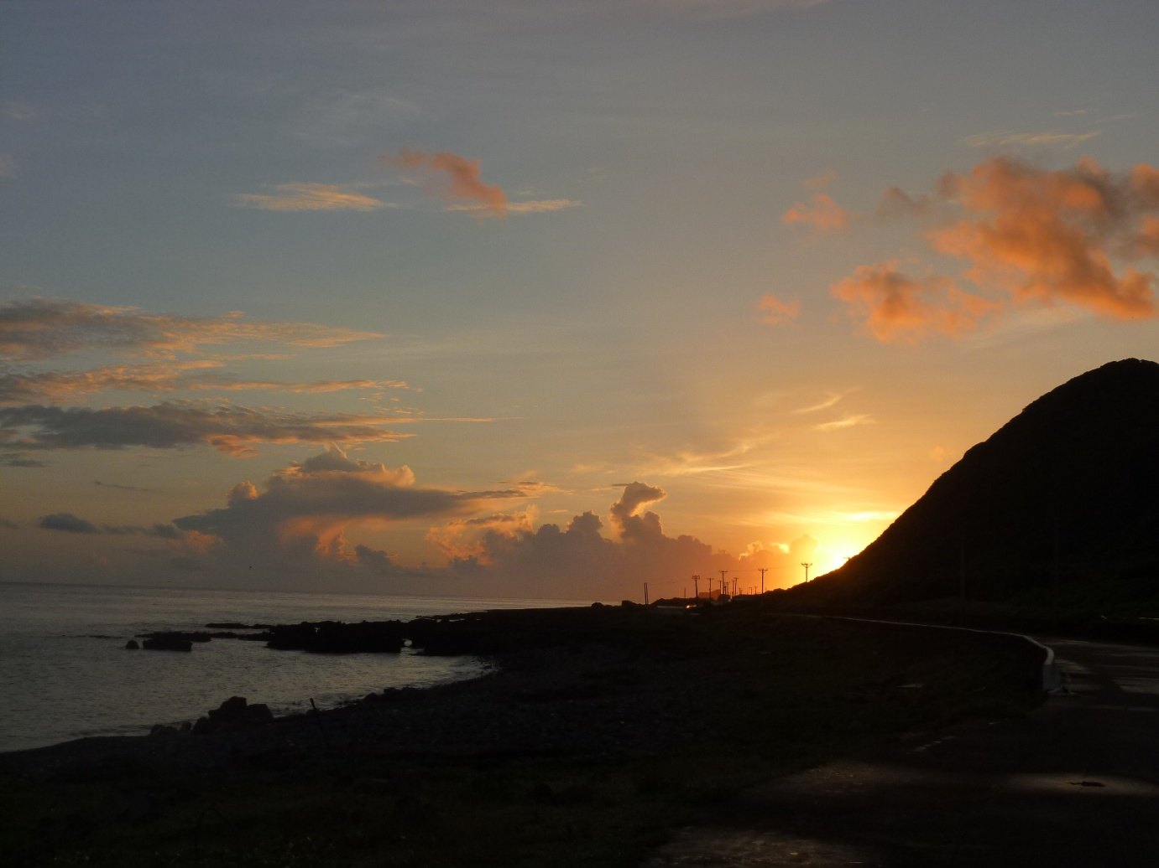
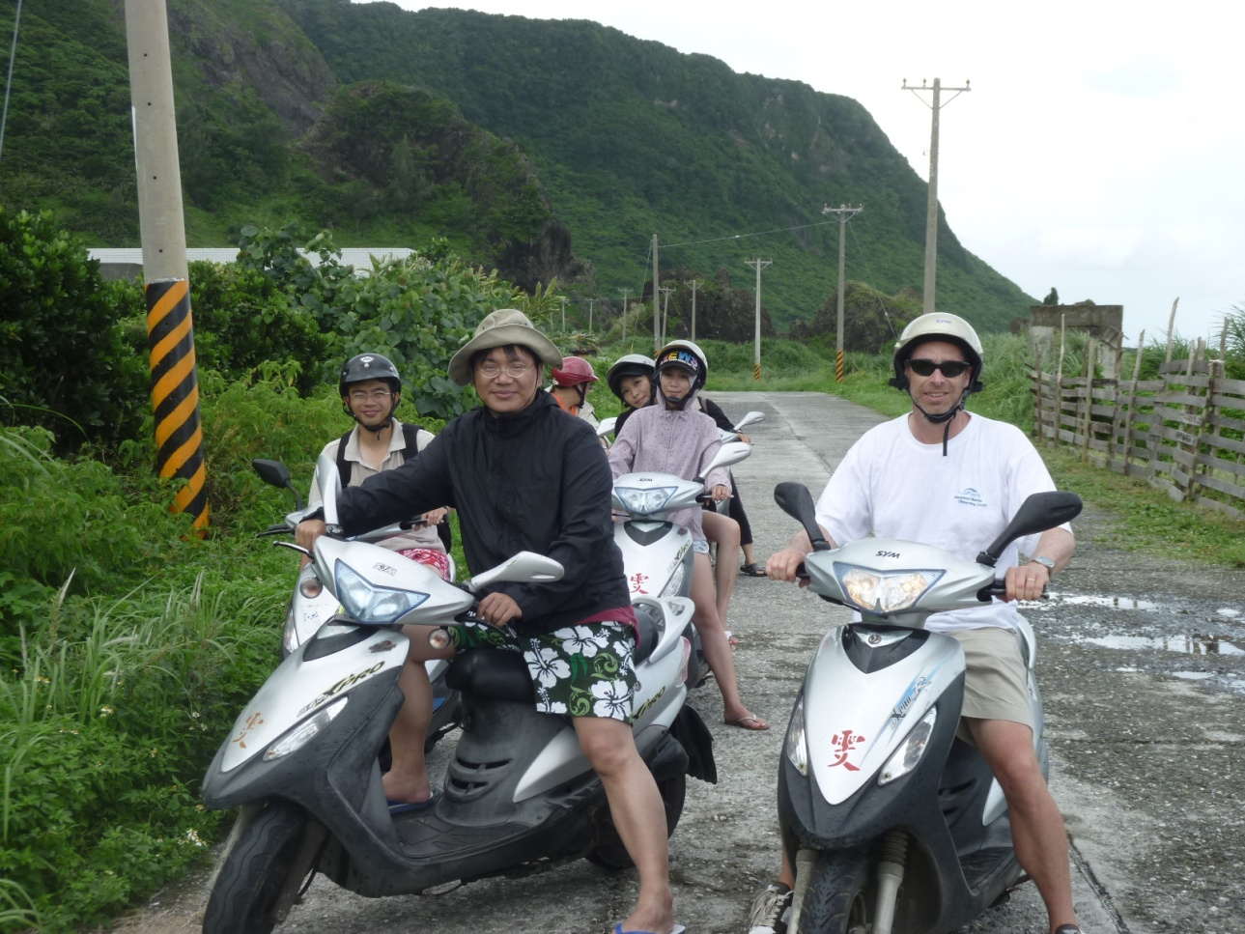
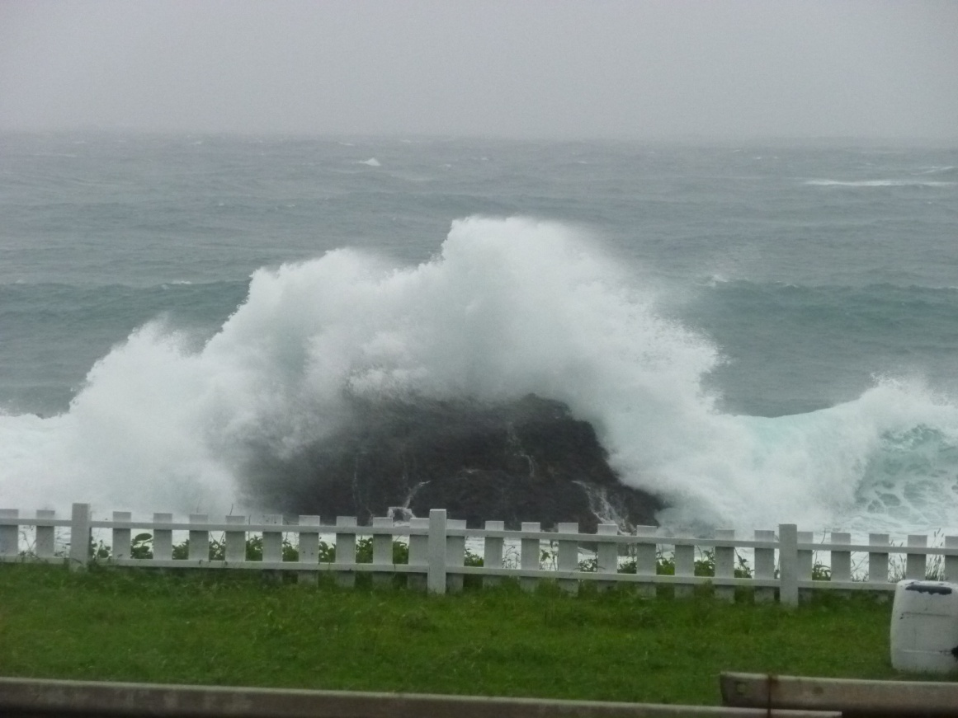

Technical meeting
Follow-up to meeting after PRAGMA 18 in San Diego
NECTEC made connection to Racha Island
Additional funding from US NSF
Help establish node at Racha Island
Help build community of scientists
Additional time for meeting on Lanyu
Typhoon

Slide 21

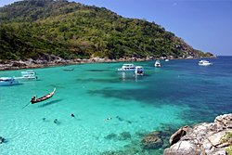


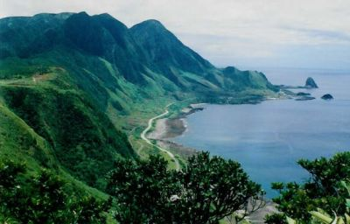
Great Barrier Reef
Racha Island
UCSD
Moorea
Orchid Island (Lanyu)

Slide 22
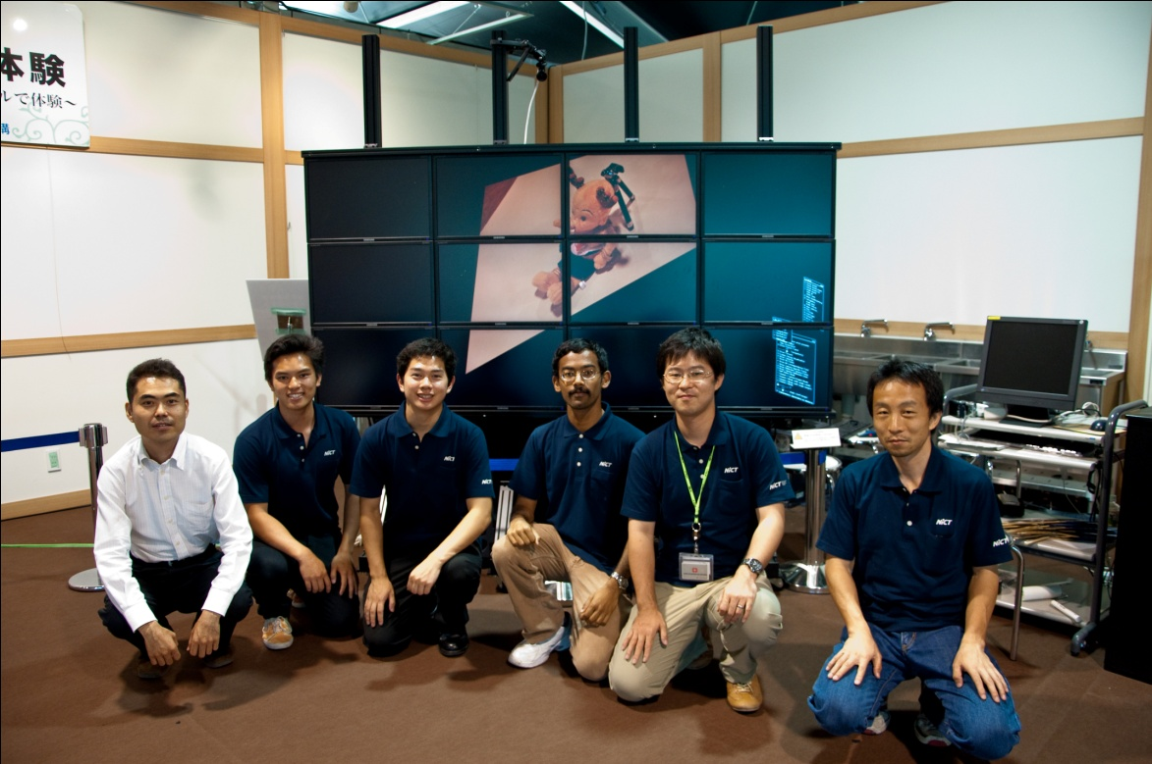
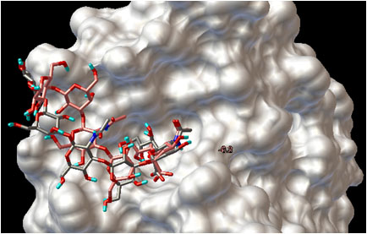
PRIME Research Apprenticeship Cultural Immersion
Seventh year
29 Students
11 Institutions
Project areas:
Avian Flu (CNIC – 14)
Docking
Environmental Observing
Cardiac Modeling
Visualization (NARA Exhibit)
Virtualization of resources
Finish creating a virtual cluster
between Osaka University and
UCSD using PIAX and OpenVPN
as the virtual network!
Notes:
14 students since 2005
Yes, this is the exhibition site although it is like a hut.

Slide 23
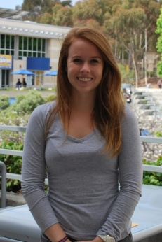
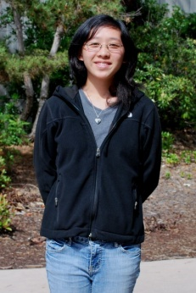
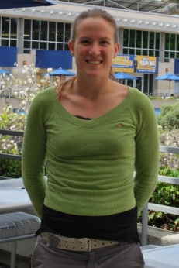
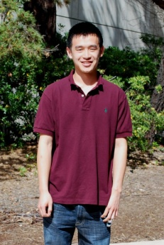
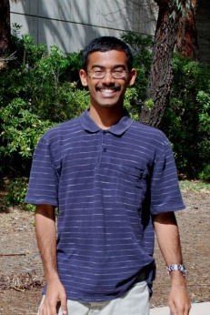
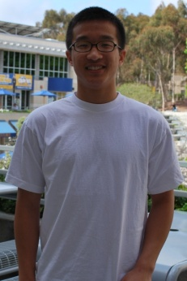
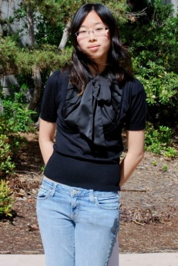
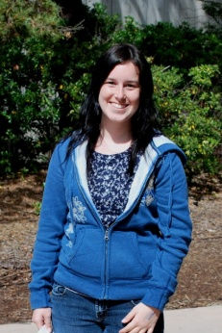
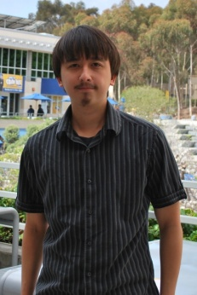
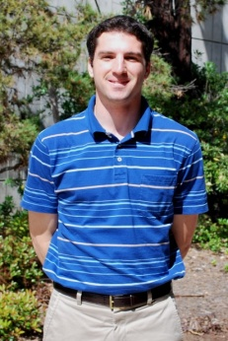
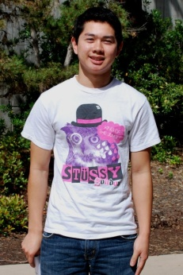
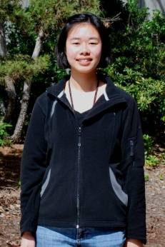
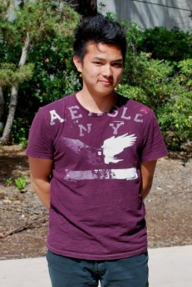
















Face of PRIME 2010
Monash –
Melbourne
CNIC –
Beijing
TFRI –
Taipei
NICT –
Tokyo
Doshisha –
Kyoto
U Hyderabad
Osaka U
USM –
Penang
NCREE –
Taipei
U Auckland
NTU –
Taipei

Slide 24
Other Exchanges
Osaka Postdoc
MURPA Students
PRAGMA TREE: Apartment

Slide 25

Awards and Honors
Asia GEO Grid Initiative Awarded (1 July 2010): Lead Yoshio Tanaka
AIST, NECTEC, NARL/NCHC and VAST
David Abramson
The Vice-Chancellor's Award for Excellence in Innovation and External Collaboration was awarded to Professor David Abramson.
“Thanks ... couldn't do it without collaborators :-)”
Karpjoo Jeong
Appointed director of UBITA (institute for ubiquitous information technology and applications), May 2010.
Notes:
Asia GEO Grid Initiative has been accepted and started on July 1. The participating institutions are AIST, NECTEC, NARL/NCHC and VAST.
http://www.monash.edu.au/news/monashmemo/assets/includes/content/20100825/stories-lead.html

Slide 26




IRNC Award to Indiana
Notes:
5-7 December
Workshop in India
Concurrent Afternoon Tutorial 4 - What makes for a successful Indo-US network-enabled collaboration Tutorial leaders: Arun Agarwal and Chaitan Baru Drawing on the experiences of the GEON and PRAGMA initiatives as examples, highlighting successes, areas for improvement, expectations on both sides, etc. This is not a technical tutorial, but sets out a very practical and valuable approach to developing successful network-enabled science collaborations between US and India.

Slide 27

Upcoming Meeting
GLEON 11: 17 – 22 October, Nanjing
CAS/Niglas
CREON:
Technical Session, December at e-science meeting in Melbourne
PRAGMA 20: 2 – 4 March 2011, Hong Kong
University of Hong Kong

Slide 28
Strategic Planning Meeting
Successes, Opportunities, Challenges: Mason Katz
Technology Trends: Yoshio Tanaka
Application Opportunities: Fang-Pang Lin
Education, Outreach and Training

Slide 29
Successes
Exchange of ideas, technologies, people
Helping raise support for funding; helping with people’s careers
Providing platform to develop other communities and projects

Slide 30
Steering Committee Meeting
Continue Strategic Planning Discussions
Review Organizational Structure in light of new possible trends
Dissemination activities this year
Brochure?
SC10?
Future meetings

Slide 31
Charge to Working Groups based on Strategic Planning Discussions
Resources Working Group
Continue discussions about technology trends to report back to the group
Other Working Groups
Consider what level of engagement your working group activities address:
Leading scientists working with you to produce science
Interacting with scientists to produce prototype infrastructure
Providing services to scientists

Slide 32
Posters and Demos
Effects of Urban Land Use Change and Anthropogenic Heat on Weather Variables in Summer over Guangzhou-Shenzhen in South China by using WRF Model
Evaluation of Next Generation Sequencing software in mapping and assembly
Elastic Virtual Cluster for Parallel Applications in Metascheduler CSF4
New CSF-OPAL cloud environment: scheduling multi-domain cloud resources
EDISON (Education-hub Development by converging high-end IT and computational Science for providing new Opportunities to the Next generation)
Ecological Observation Viewer for Monitoring Lake Ecosystem
High Performance File System Service for Cloud Computing
COLLABORATION ENVIRONMENT FOR E-SCIENCE: DUCKLING AND DISCIPLINE APPLICATIONS
Dementia Detection System on Smart Computing Environment
Fault Tolerance for HPC with OpenVZ Virtualization By Light Migration Toolkit
On-Demand Virtual Cluster in Cloud Web-Based OS Environment
NetKarma: Provenance Aggregation Across Layers of GENI Experimental Networks
AND MORE
ASK THE PRESENTERS ABOUT THEIR WORK!

Slide 33
Thank you!

